Slide 1
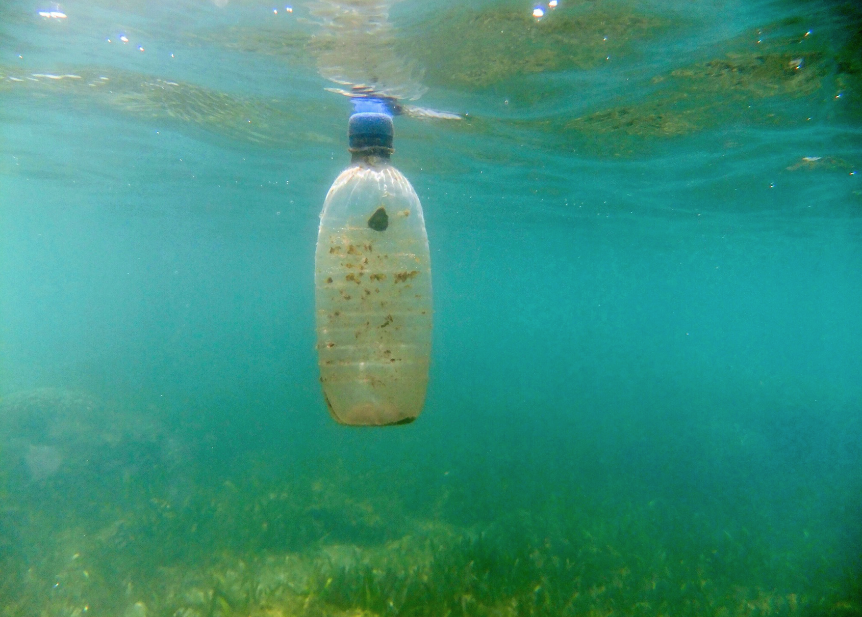
Food or a free ride? The ability of a marine microbial community to degrade plastics
Robyn Wright
Joseph Christie-Oleza and Matt Gibson
University of Warwick
SLS Symposium 2019
@RobynJWright
Notes:
Hello everyone, I’m Robyn, I’m in the final year of my PhD now, and I’ve been looking at microbial colonization and degradation of plastics and associated compounds, and I’m just going to try and quickly skim through everything that I’ve been doing for that.

Slide 2
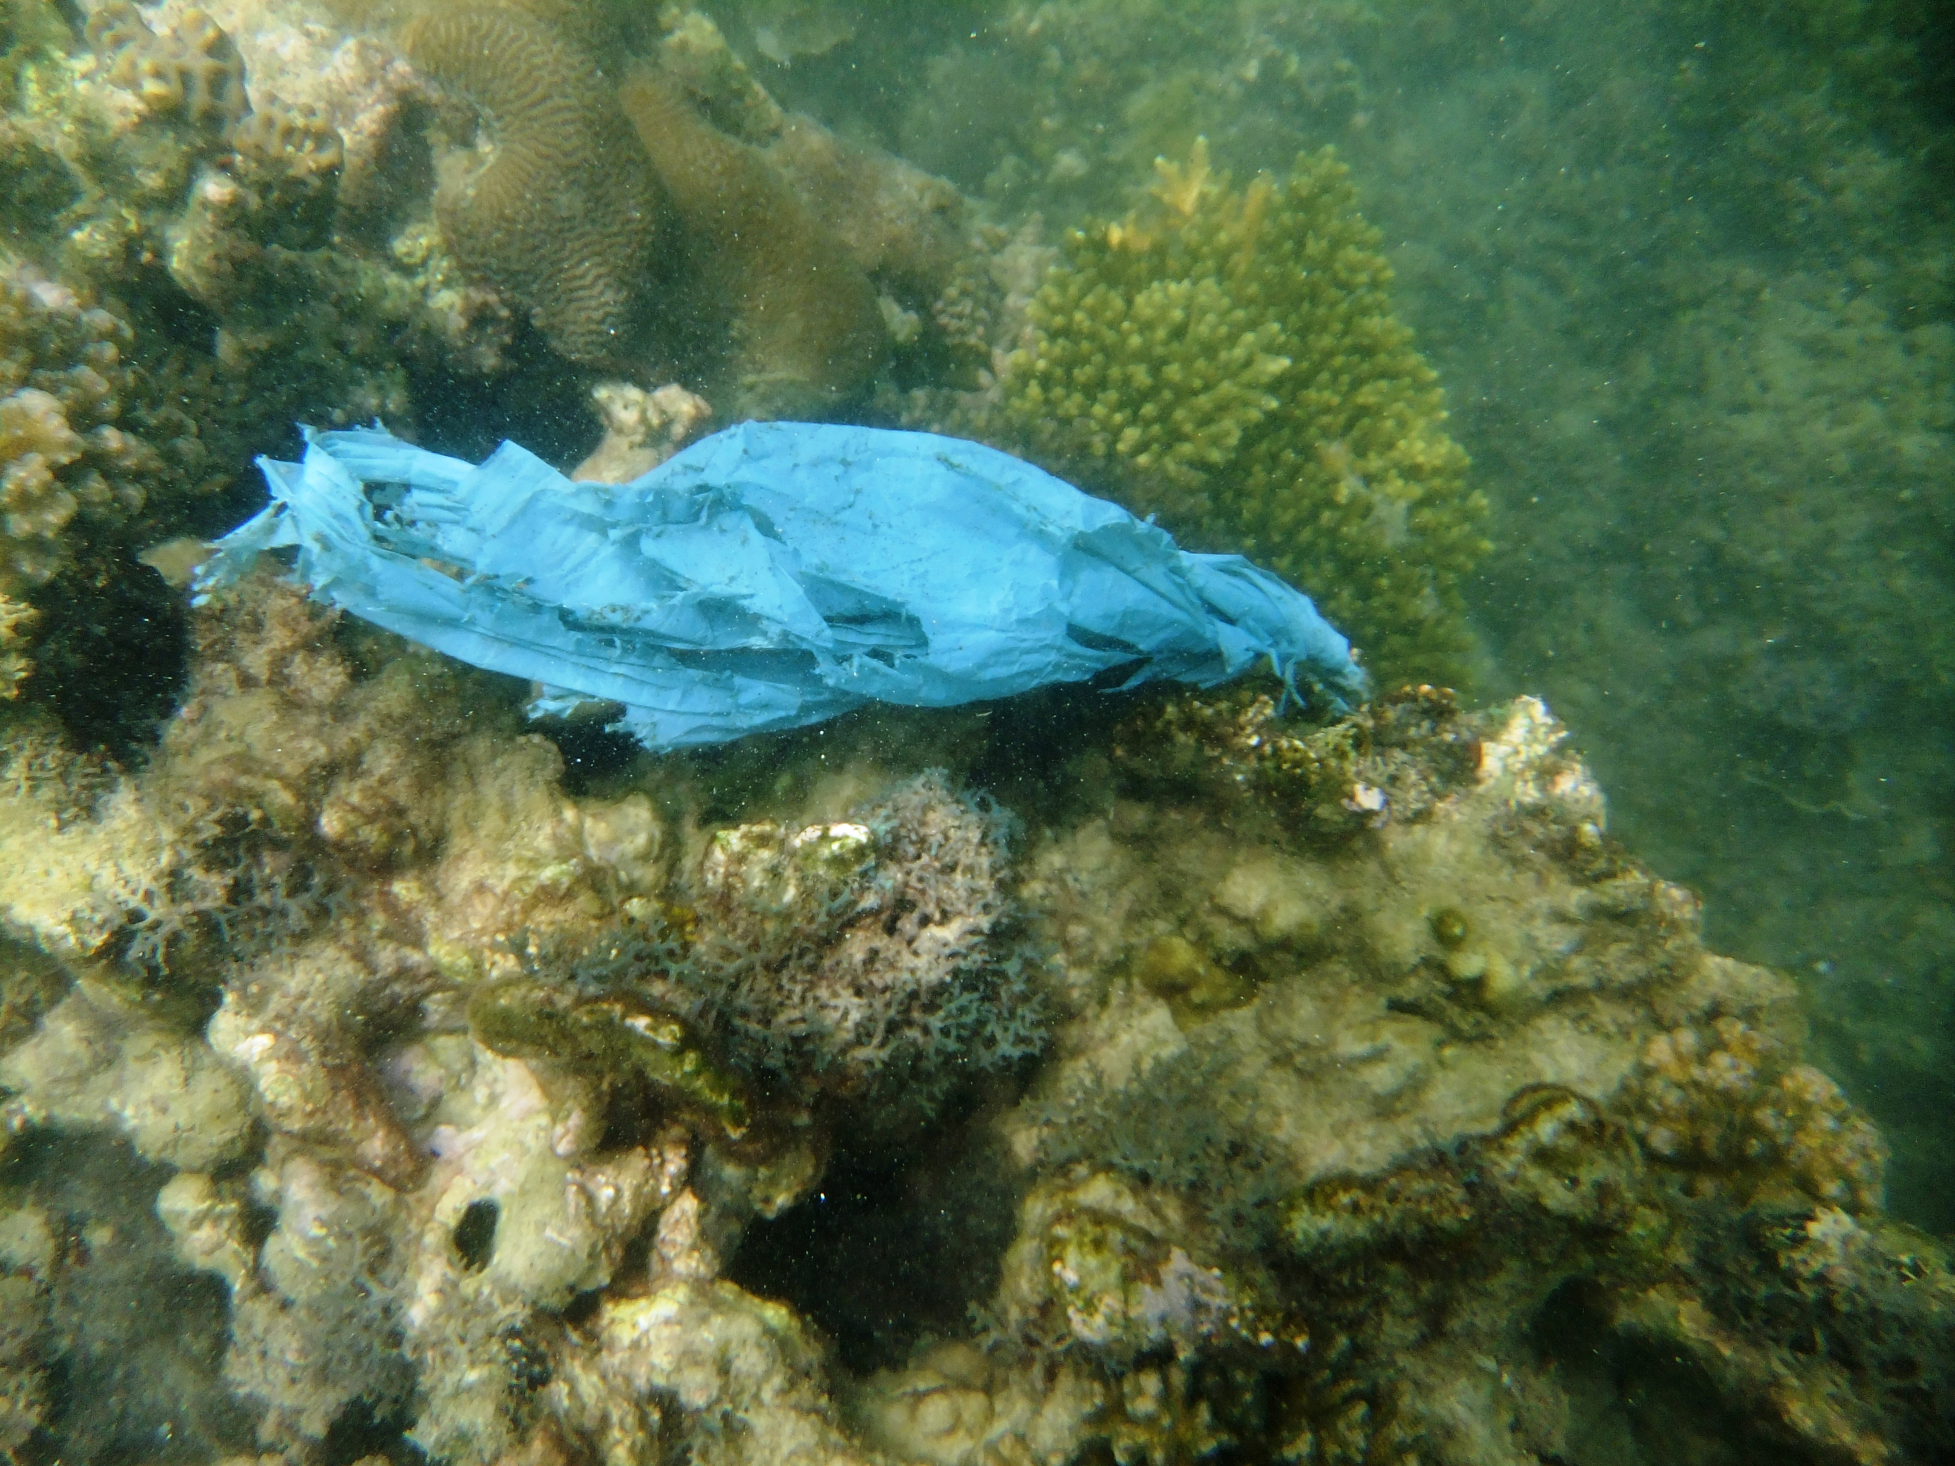
INTRODUCTION – PLASTICS IN THE OCEAN
Notes:
I’m sure you all know, but the ocean is now full of plastics, and, as we often hear, these could take “hundreds of years to break down”, and so increasingly people are looking to the microbes, and therefore biodegradation of plastics, to find a solution to this problem.

Slide 3
WHAT HAPPENS TO A PLASTIC BOTTLE IN THE OCEANS?
IS IT BEING DEGRADED? WHO IS DEGRADING IT?
OBJECTIVES:
Fundamental understanding of marine microbial communities
2. Are plastics degraded?
3. Are the additives and contaminants of plastics being degraded?
Notes:
Several studies have now found terrestrial microorganisms that degrade plastics, but what we want to know is what happens to a plastic bottle like this one in the marine environment? Is it being degraded, and if so, who is degrading it?
So, the main objectives of my PhD were therefore to gain a fundamental understanding of marine microbial communities, to determine whether plastics are being degraded, and whether the contaminants and additives of plastics are being degraded.

Slide 4
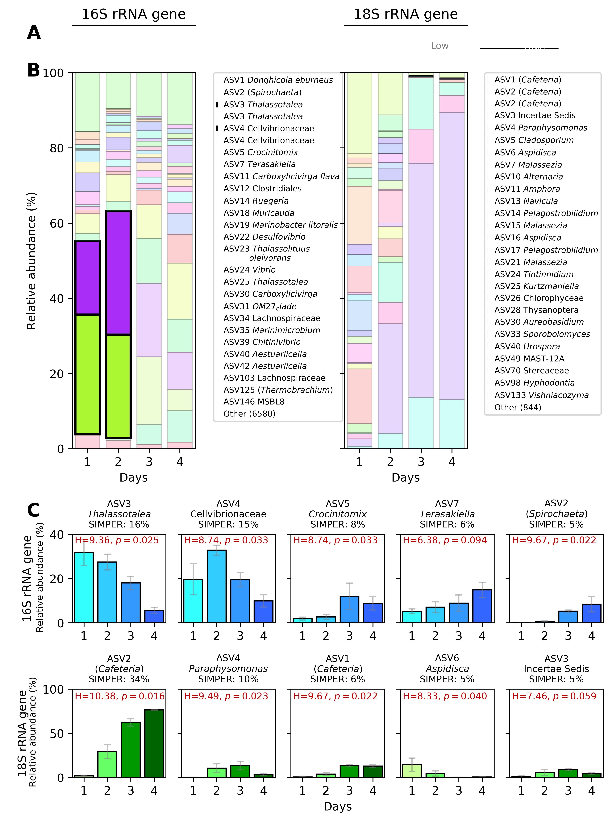
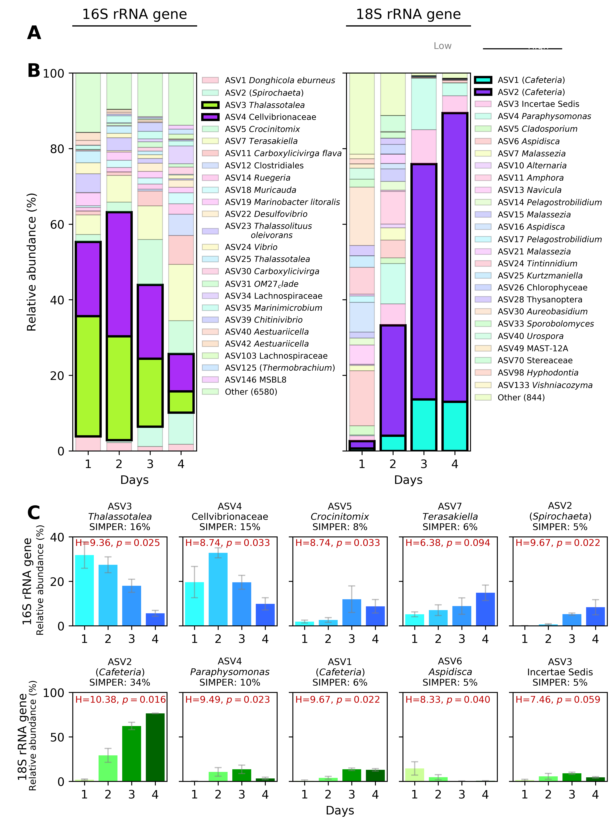
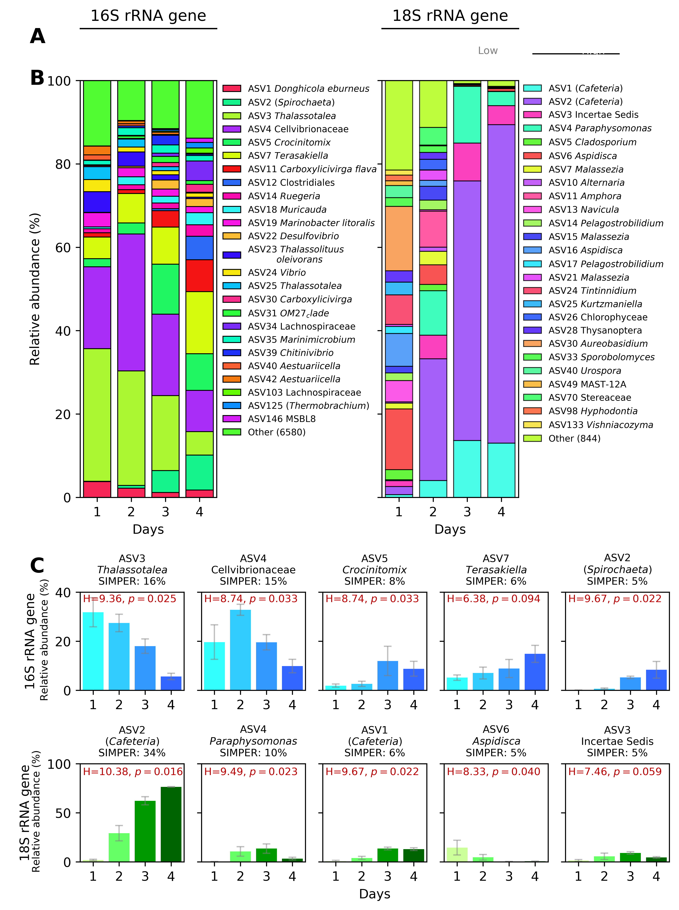
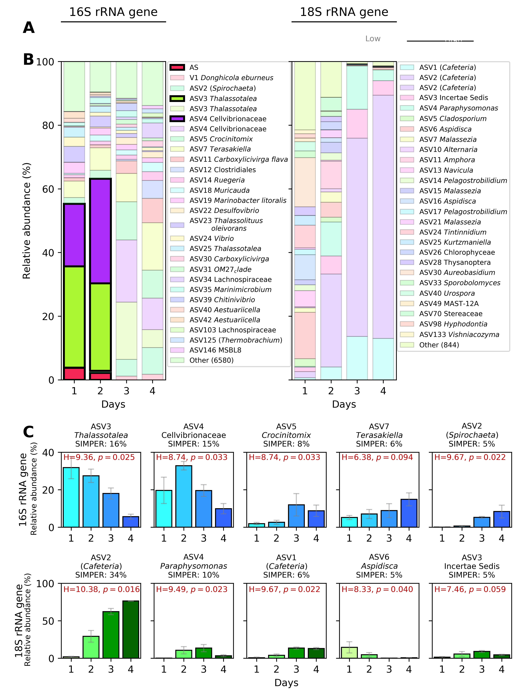
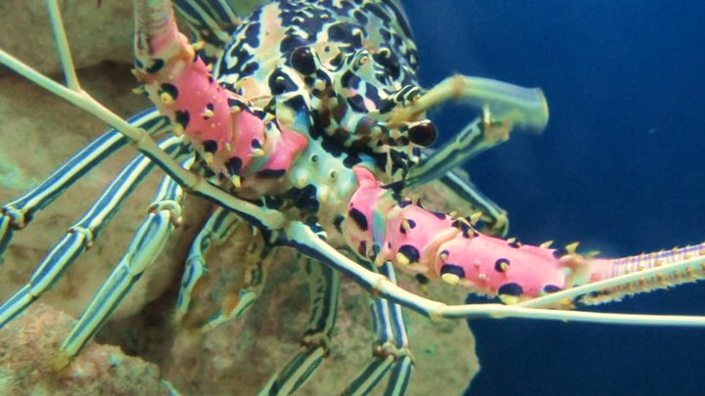
OBJECTIVE 1: UNDERSTANDING MARINE MICROBIAL COMMUNITY DYNAMICS
16S rRNA gene
Prokaryotes
18S rRNA gene
Eukaryotes
CHITIN
Wright et al. (Second round revision for Microbiome)
Notes:
So how can I look for degradation of polymers like plastics? In order to do that, we first needed to have a more labile polymer to understand degradation – chitin, and in this first part, we learnt a lot. So basically, before I looked at the incredibly challenging to degrade plastics, I needed to have some idea of what I might be looking for, and when I would be looking for plastic-specific groups, so I looked at microbial community succession on chitin.
Chitin is the most abundant natural polymer in the oceans, it makes up the shells of organisms like crabs and shrimps, and, most importantly for us, its readily degraded by marine microbes and the enzymes used for this are already well characterised.
We looked at the microbial community succession across 4 days of incubation, and found distinct patterns in the abundances of different organisms. We looked at the 16S and 18S rRNA gene communities, broadly speaking for the prokaryotes and eukaryotes, respectively, and here we're looking at the relative abundance of these organisms.
So for the 16S we see a peak in the abundance of these two organisms on the second day, when enzymes to degrade chitin also peaked, and then we see a decline, and at the same time, in the 18S community, we see a huge increase in these two organisms – bactivorous marine flagellates, or grazers.
Obviously there’s a lot more that I found out than this, but the take home is...

Slide 5
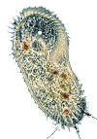
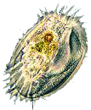
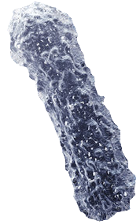

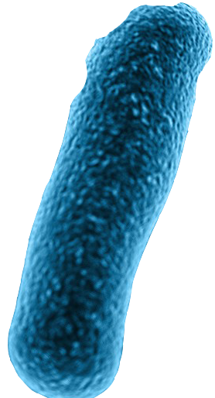
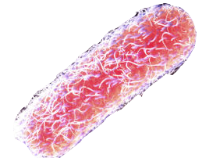
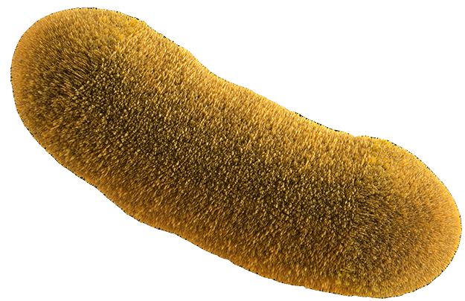
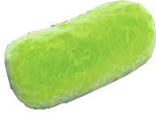
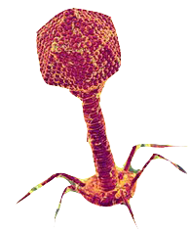
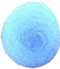

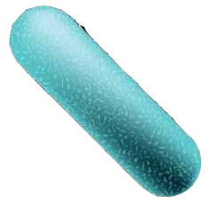
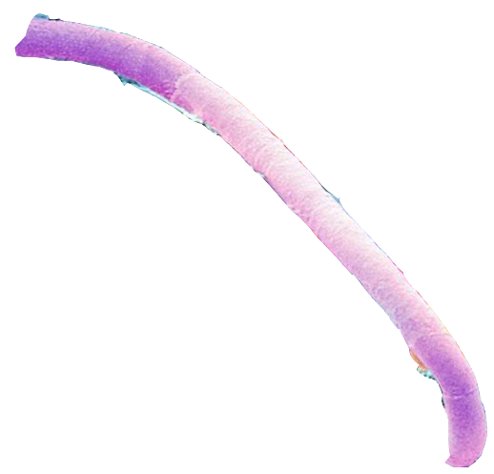
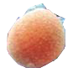

OBJECTIVE 1: UNDERSTANDING MARINE MICROBIAL COMMUNITY DYNAMICS
COLONISATION
SELECTION
SUCCESSION
Enrichment of members that can degrade
Community succeeded by:
Cheaters
Grazers
Viruses
Wright et al. (Second round revision for Microbiome)
Notes:
These findings from chitin actually fit nicely with what we know about microbial community ecology – we often see an initial colonization phase – characterised by an abundance of organisms that are just good at attaching to particles, then we see a selection phase, characterised by high abundances of organisms that are actually able to degrade, and then a succession phase, where these degraders are overtaken by cheaters, grazers and viruses. So these cheaters would be organisms that can’t degrade themselves, but benefit from those that do by utilizing the sub-products of degradation.
OK, so this told me about microbial community ecology, and showed me that if I wanted an efficient degrading community then we really needed to be looking at the right time, but for the second part of my PhD

Slide 6
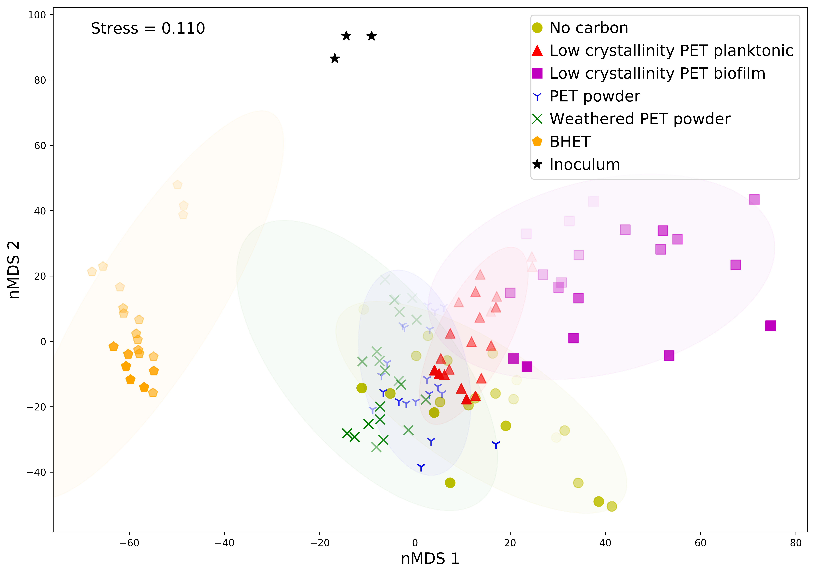
OBJECTIVE 2: APPLY FINDINGS TO PET (PLASTIC) DEGRADATION
PET monomer (BHET)
Low crystallinity PET
PET/ weathered PET/other
Wright et al. (In prep.)
Notes:
we wanted to apply this knowledge from chitin to how microbial communities degrade something like this PET bottle. So instead of 4 days, here we characterised the microbial community across 6 weeks, and here I’m looking at only the 16S rRNA gene community. Commercial PET is very challenging to degrade, but we see a clear differentiation of communities with clear changes.
Now, I just want to give you a quick overview here, so please don’t look at this in too much detail. So this is an nMDS plot, so points that are close together are similar communities. So I first removed the inoculum from plastics that I collected from the beach, and that’s these points up here. Over here we have BHET – which is the PET monomer and is semi-soluble, so therefore much easier to degrade. And then over here we have low crystallinity PET – so crystallinity basically just refers to how tightly packed the chains of the polymer are, and it being low crystallinity means that the chains are more easily accessible for microbial attack. And then we have everything else here, including my no carbon control.
Measuring actual growth of biofilms is really challenging, so I am kind of assuming that the reason these are similar to the no carbon, is that they actually just aren’t growing very much, and I therefore decided to focus on the low crystallinity going forwards.

Slide 7
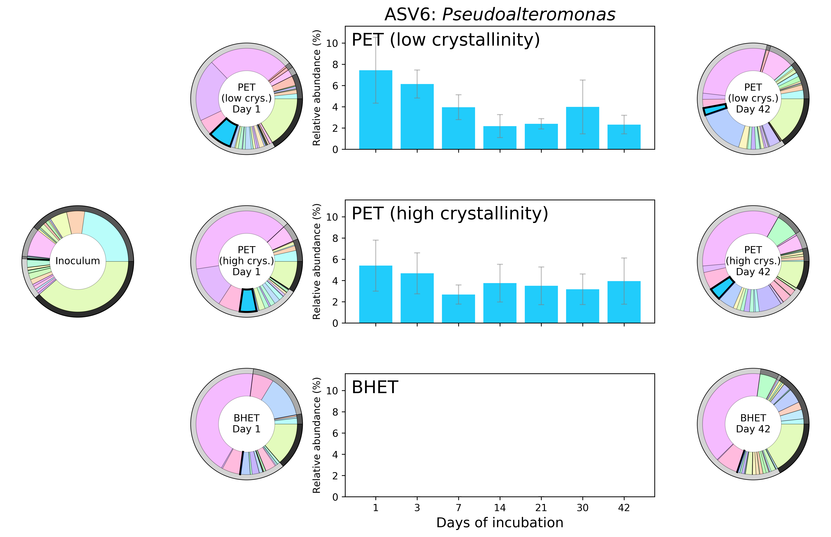
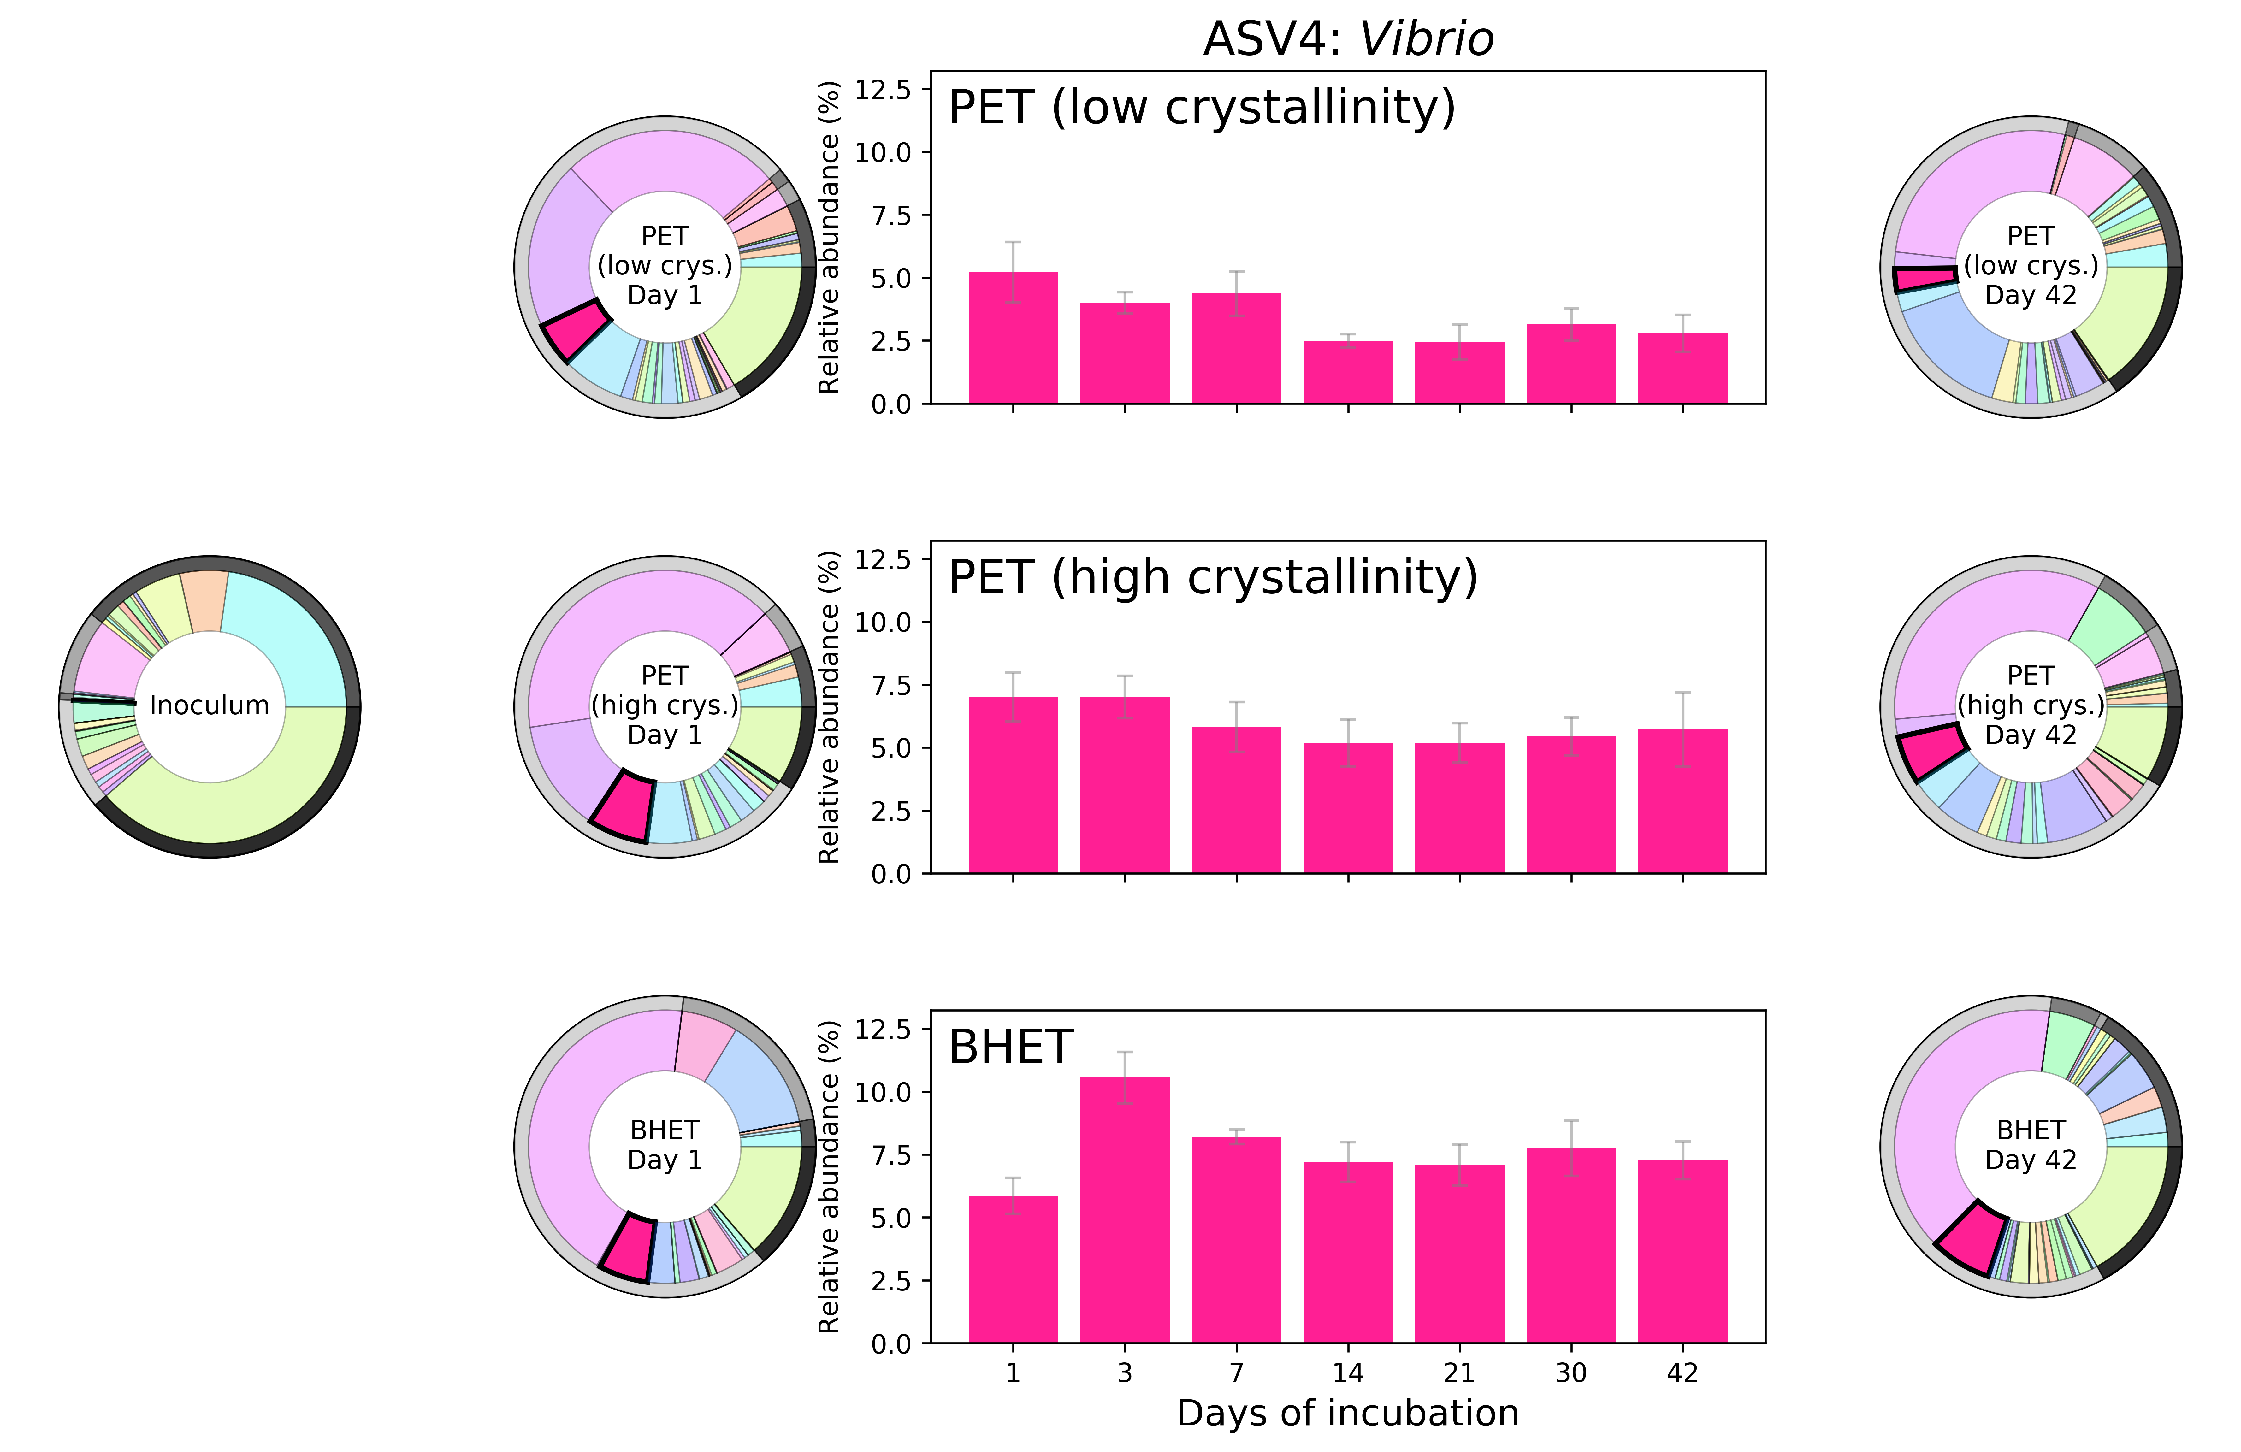
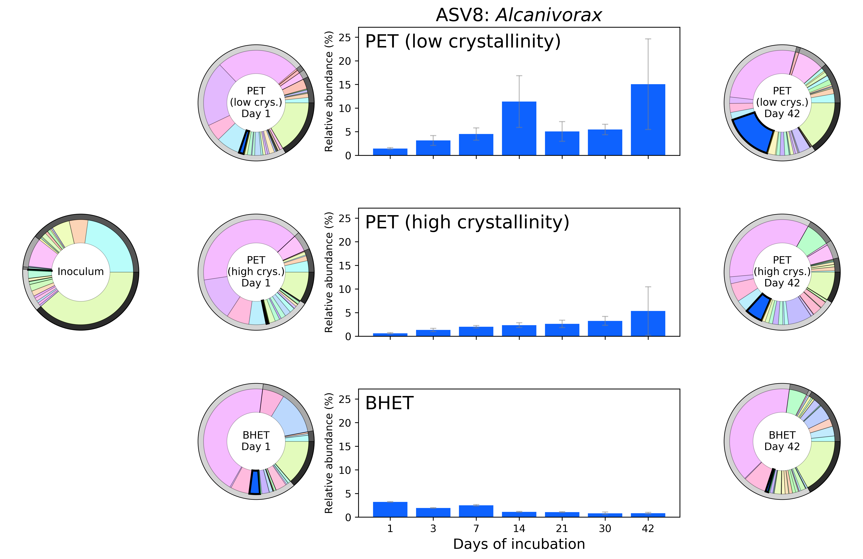
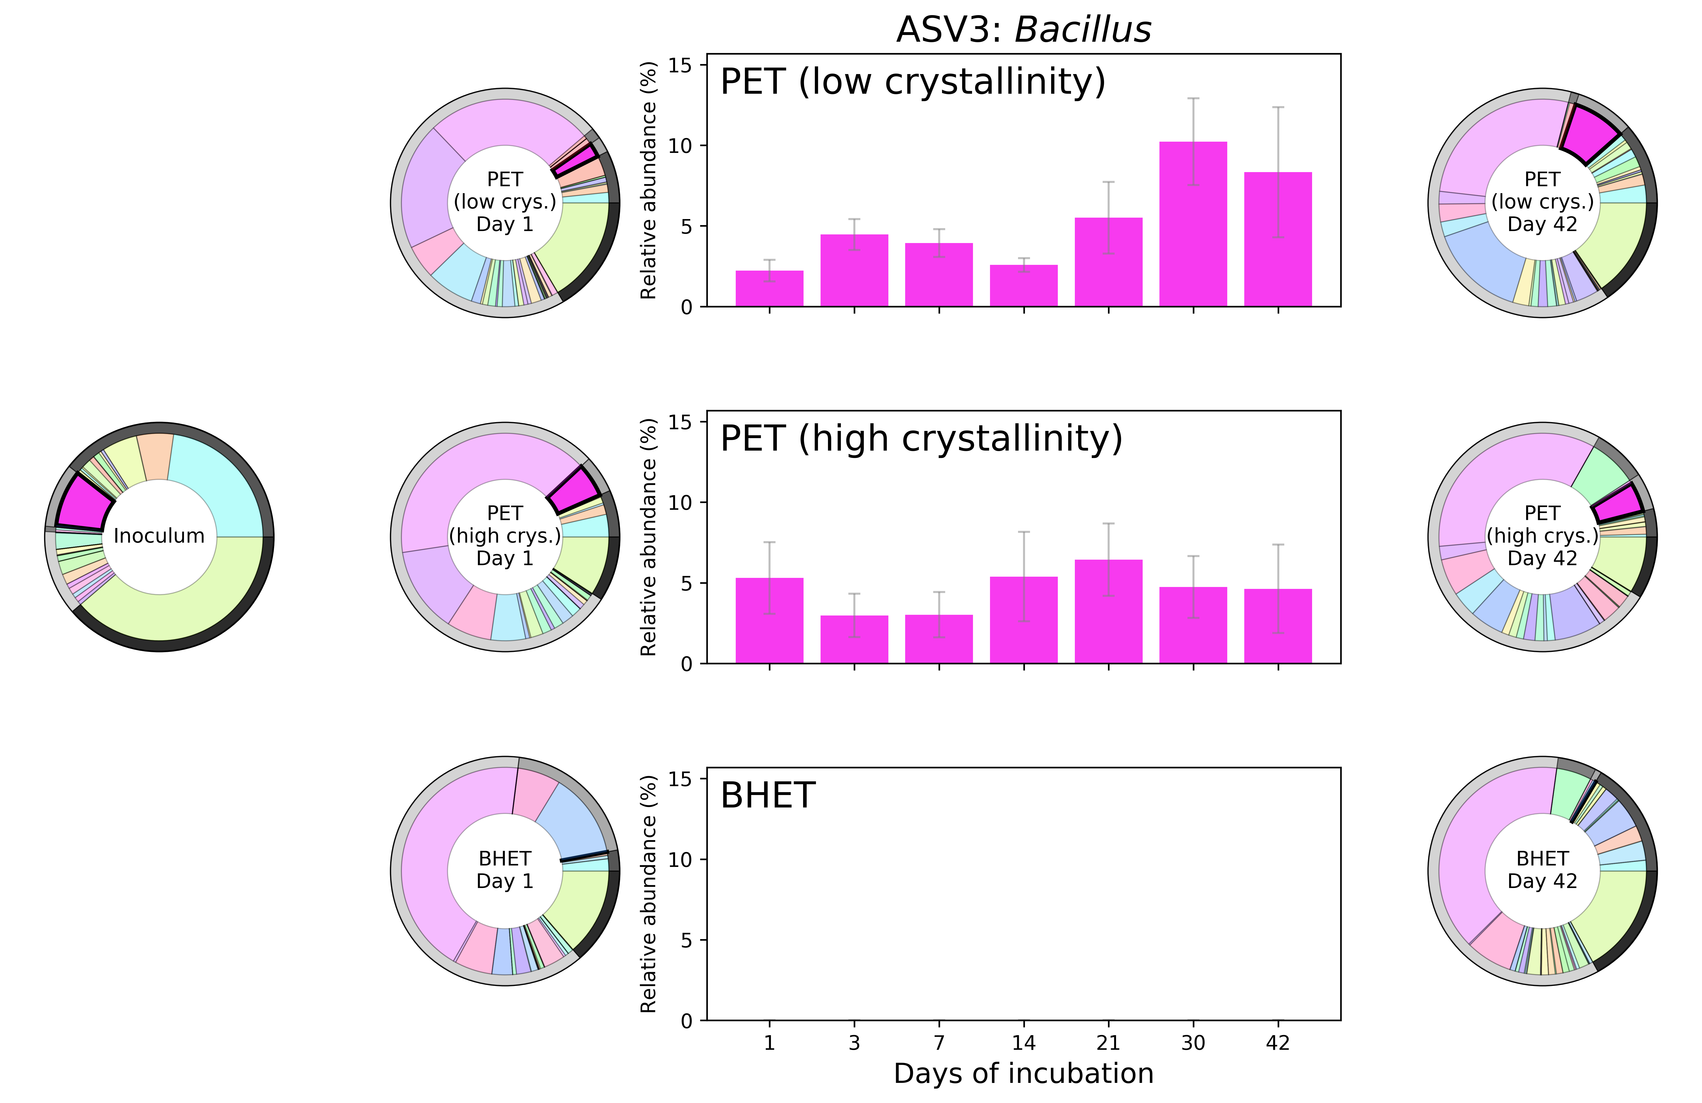
OBJECTIVE 2: PET COMMUNITY CHANGES
Wright et al. (In prep.)
Notes:
From our community analysis, we can see some bacteria that decrease in abundance over time, and that these are then overtaken by things like Bacillus and Alcanivorax, that are characterised as degraders.
BUT the only way to really characterise the molecular pathways involved in degrading plastics is to isolate these and then carry out a detailed analysis of these isolates.

Slide 8
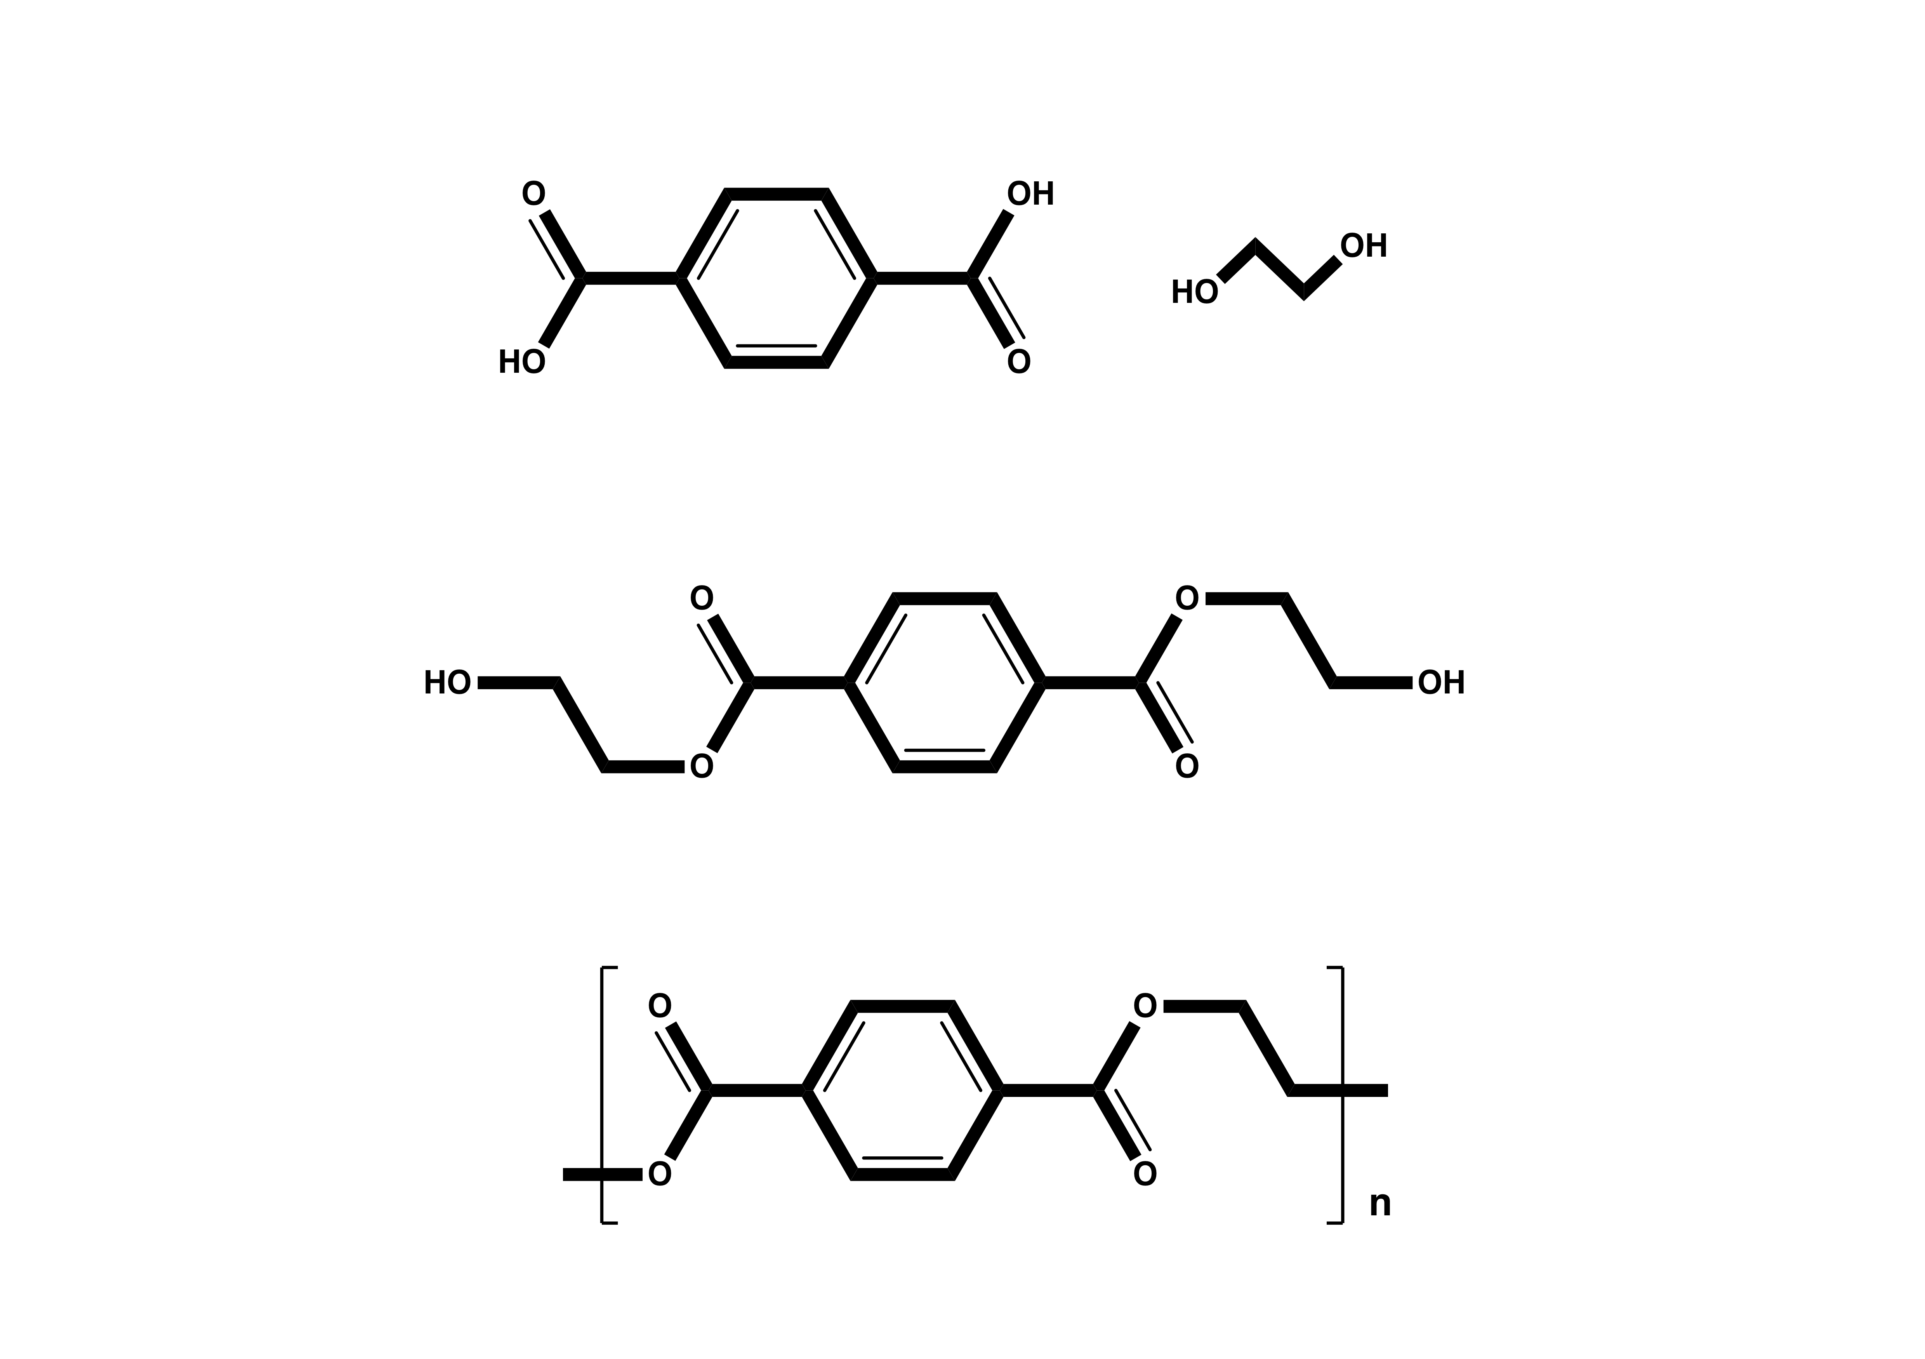
OBJECTIVE 2: PET DEGRADATION
BHET
Wright (2019) Biological Sciences Review (magazine article)
Notes:
OK, so the pathway for PET degradation has been determined for bacteria on land, and we want to try and identify the enzymes capable for things like this in the ocean. So, the PET polymer chains are broken to produce MHET, which you’ll see is very structurally similar to BHET, that I used as a substrate for my succession experiment, and then this is further hydrolysed to terephthalic acid and ethylene glycol, both of which are readily used as carbon sources.

Slide 9
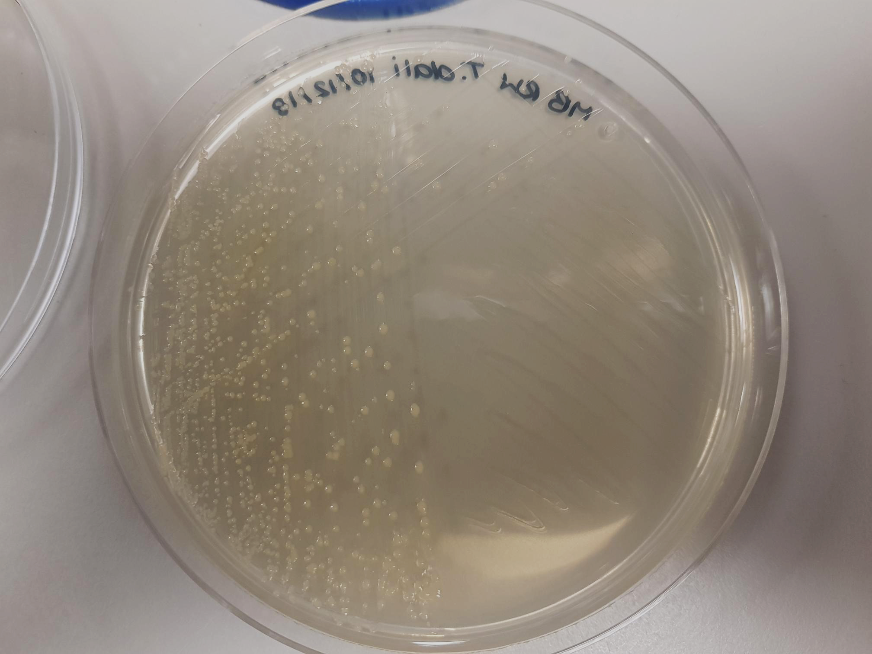
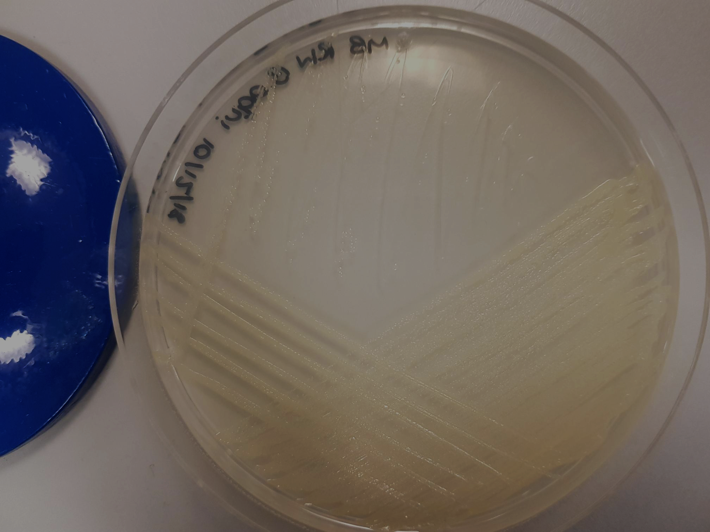
OBJECTIVE 2: PET-DEGRADING ISOLATES
PET
PET monomer (BHET)
Enrich
Isolate
Characterise degradation
✅
✅
⚠️
Thioclava sp.
(Alphaproteobacteria)
Bacillus sp.
(Firmicutes)
Proteogenomic characterisation
Genomes sequenced
Proteomics
Analysis of proteomics
✅
✅
⚠️
Wright et al. (In prep.)
Notes:
So to look at how microbes degrade plastics, we enriched, isolated, and now we’re trying to characterise how these organisms degrade, and that’s the last thing I need to do before I finish my PhD. So, I isolated a series of organisms, and two that showed potential and good growth with our PET monomer, BHET, were these two, Thioclava and Bacillus.
Many studies often lack the actual pathway that is used for degradation, and through a detailed proteogenomic characterisation of these two bacteria, we hope to determine that. So we’ve sequenced their genomes, and carried out proteomics when they were grown with a range of different substrates and PET degradation intermediates. I got this data last week, so now I just need to go through it and hopefully identify the pathways used by marine bacteria for PET degradation.

Slide 10
OBJECTIVE 3: TOXIC CHEMICALS ASSOCIATED WITH PLASTICS - PLASTICIZERS
Wright et al. (In prep.)
Notes:
Finally, the third objective of my PhD was to see not only the degradation of the polymer, but the potential additives of plastics. So plasticizers are chemicals that are added to plastics during manufacturing in order to improve their physical properties and for example

Slide 11
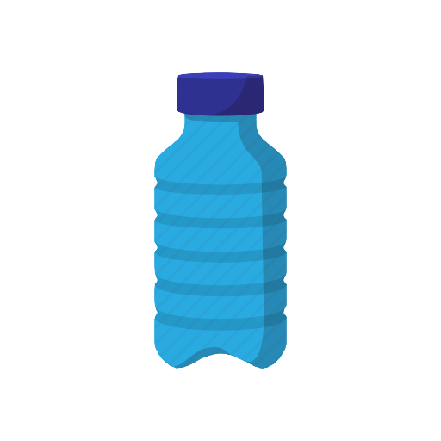



OBJECTIVE 3: TOXIC CHEMICALS ASSOCIATED WITH PLASTICS - PLASTICIZERS
Endocrine disrupting
Carcinogenic
Mutagenic
Deadly
50%
Wright et al. (In prep.)
Notes:
in PVC, up to 50% of the weight of the plastic can be made up of these chemicals.
Many of them are known to be endocrine disrupting, carcinogenic, mutagenic and even deadly, and because they are not chemically bound to the plastics, its now well documented that they can leach out from the plastics and become available not only to the environment, but also to microbes that can degrade. So our objective here was to identify who is degrading and how are they being degraded in the marine environment, and this is the first thorough proteogenomic characterisation of plasticizer degradation in the marine environment.

Slide 12
OBJECTIVE 3: PLASTICIZERS EXPERIMENTAL SETUP
Bis(2-ethylhexyl phthalate (DEHP)
Dibutyl phthalate (DBP)
Acetyl tributyl citrate (ATBC)
Phthalic acid esters
Toxic
Citrate
Biodegradable
42
Halomonas sp. ATBC28
10
2
Mycobacterium sp. DBP42
ISOLATES
Proteogenomic analysis
Wright et al. (In prep.)
Notes:
So I chose to work with two toxic plasticizers, which together make up about 65% of the plasticizer market, DEHP and DBP, the phthalic acid esters, and one that is widely stated to be a good alternative to these, because it is biodegradable, ATBC, a citrate plasticizer. However, we couldn’t actually find any study that showed degradation. So we wanted to see if the mechanism for degradation would be the same for these two, and then if this one really was biodegradable....
So we originally isolated 42 bacteria that were able to grow with these plasticizers, as well as three others, narrowed this down to ten that showed good growth with more than one, and then chose two that could grow with all of them, Halomonas and Mycobacterium. So we carried out a thorough proteogenomic analysis, through sequencing of their genomes and carrying out proteomics. So I carried out proteomics with these three plasticizers, as well as phthalic acid, a degradation intermediate of these two that I’ve now highlighted in red.

Slide 13
OBJECTIVE 3: PATHWAYS FOUND FOR PLASTICIZER DEGRADATION
Mycobacterium sp. DBP42
Halomonas sp. ATBC28
Notes:
So these are the pathways that I’ve determined from this. Obviously there is too much going on here for you to look at here, or for me to talk you through, so I just want to highlight a couple of key points...

Slide 14
OBJECTIVE 3: MYCOBACTERIUM SP. DBP42 PLASTICIZER DEGRADATION
Dibutyl phthalate (DBP)
Mycobacterium sp. DBP42
Bis(2-ethylhexyl phthalate (DEHP)
Notes:
So if we look at Mycobacterium to begin with, what’s really interesting here is that this this bacterium uses different mechanisms for the removal of the side chains from each of those phthalic acid esters:

Slide 15
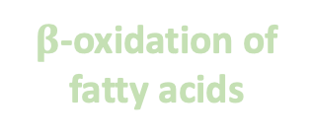
OBJECTIVE 3: MYCOBACTERIUM SP. DBP42 PLASTICIZER DEGRADATION
Dibutyl phthalate (DBP)
Butanol
Cutinase
Mycobacterium sp. DBP42
Phthalic acid
Bis(2-ethylhexyl phthalate (DEHP)
Acetyl-CoA
Benzoate degradation
$β$-oxidation of fatty acids
Phthalic acid
Acetyl tributyl citrate (ATBC)
Isocitrate lyase
25% exoproteome
Notes:
for DBP, it uses a cutinase to produce butanol and phthalic acid, and for DEHP it uses enzymes from the B-oxidation of fatty acids for the progressive shortening of the side chains to eventually produce phthalic acid and Acetyl-CoA. But these then both follow the general pathway for benzoate degradation, which is upregulated in these proteomes.
For ATBC, we find that an isocitrate lyase enzyme makes up a huge 25% of the exoproteome in this condition, so we’ve identified a potential mechanism for ATBC degradation for the first time, although its not clear whether this enzyme acts before or after the removal of the side chains, shown in red here.

Slide 16
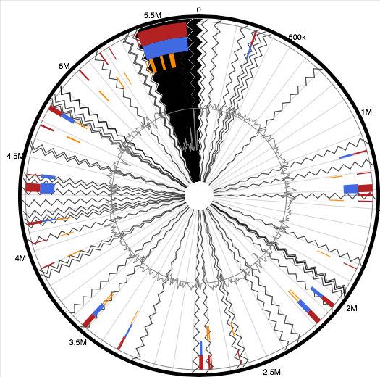
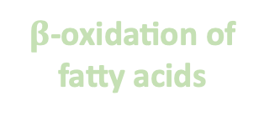
OBJECTIVE 3: HALOMONAS SP. ATBC28 PLASTICIZER DEGRADATION
Dibutyl phthalate (DBP)
Genome
Proteome
Halomonas sp. ATBC28
???
Bis(2-ethylhexyl phthalate (DEHP)
Isocitrate lyase
Acetyl tributyl citrate (ATBC)
Plasmid
$β$-oxidation of fatty acids
Notes:
The pathway for Halomonas was not so clear..... Even though this bacterium has two pathways for phthalic acid degradation in its genome,
We don’t find any of these enzymes in the proteome. It’s really not clear why this is the case, as these genes are not plasmid encoded, and they’re not part of a genomic island. But we do see enzymes for the removal of the side chains, although this bacterium probably uses enzymes from the B-oxidation of fatty acids for both, and we find that different transporters are upregulated with the plasticizers as opposed to the phthalic acid, so this degradation is probably taking place inside the cells. And then we again see isocitrate lyase upregulated in the ATBC treatment.

Slide 17
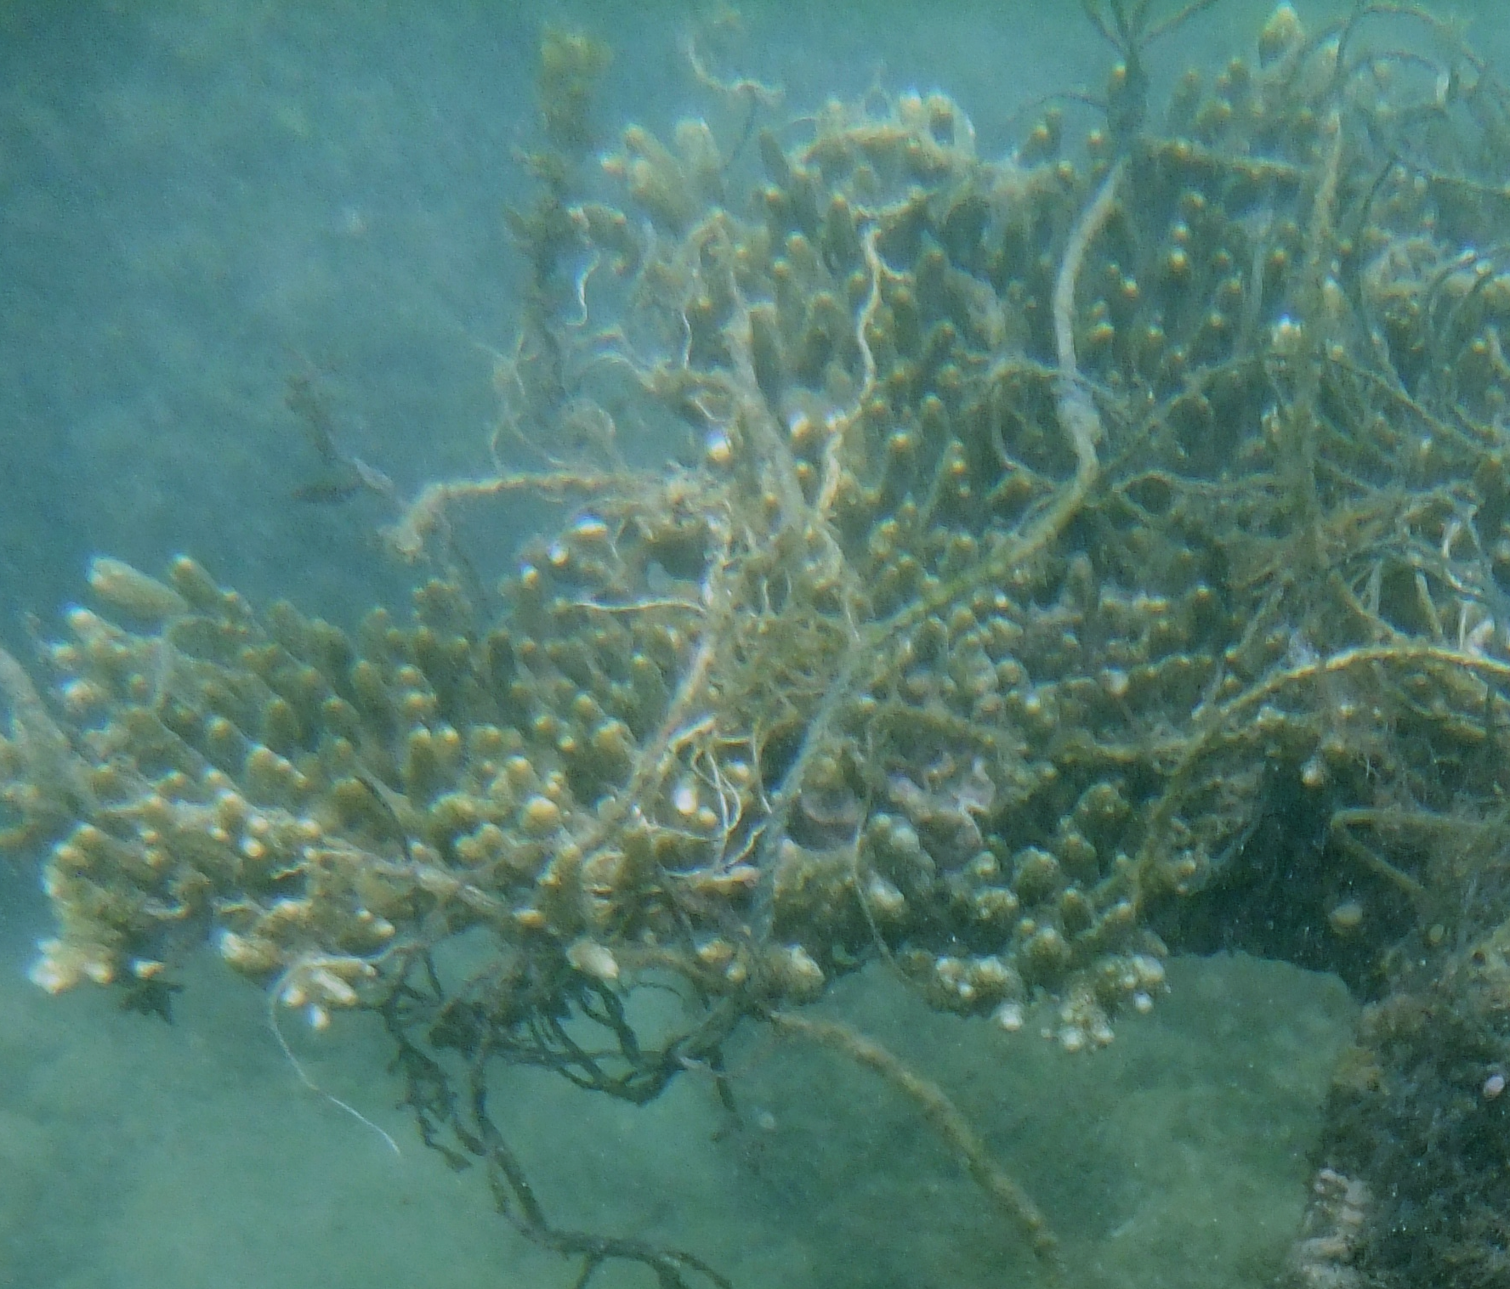
SUMMARY
OBJECTIVE 1: Community succession on chitin
OBJECTIVE 2: PET proteogenomic characterisation
Are plastics being biodegraded?
OBJECTIVE 2: PET community succession
OBJECTIVE 3: Plasticizer proteogenomics
Notes:
OK, so to try to sum up what I’ve hopefully shown here, my work on chitin has helped me to understand marine microbial community dynamics, and we saw how if our incubation time is not right, then we won’t see that efficient degrading community.
For PET, we definitely see changes in community structure over time, and some of these are in organisms that are potentially able to degrade PET, but to really determine the pathways that might be used, we need to finish off our proteogenomic analysis of PET degradation with the isolates.
And then, carrying out the proteogenomics with the plasticizer degrading isolates has allowed me to determine that one bacterium may use multiple mechanisms for degrading similar compounds, and also that having the genetic potential for degradation does not necessarily mean that a bacterium is carrying out these processes.
So to go back to this question: are plastics being degraded? Probably, but in the real world – and in the lab! – this can be extremely slow, not only because these are difficult to degrade, but because microbial ecology and succession actually might slow this down, and we have both biotic and abiotic factors to consider there.

Slide 18
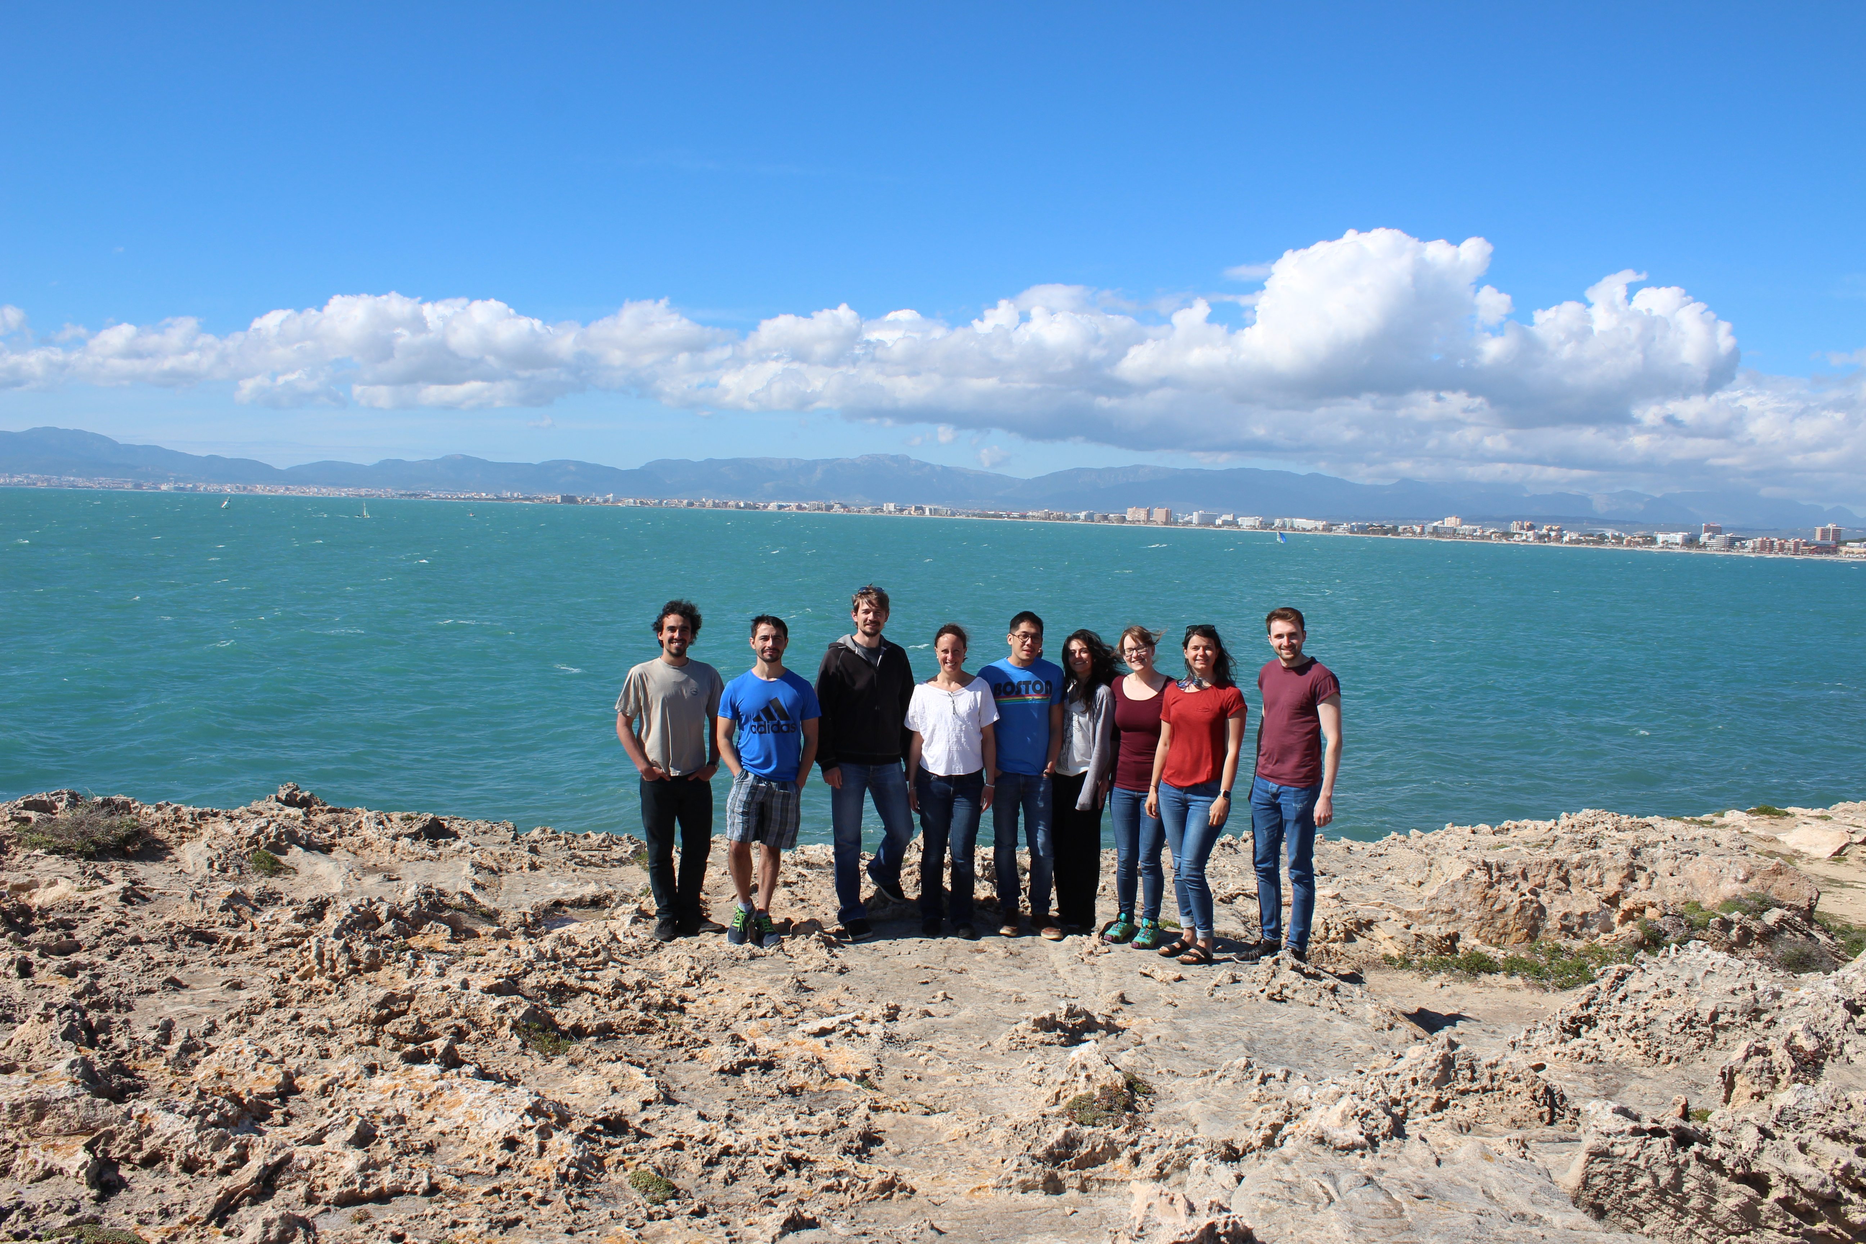
ACKNOWLEDGEMENTS
Supervisors: Joseph Christie-Oleza
Matthew Gibson
Christie-Oleza group:
Notes:
So I’d just like to thank my supervisors and my group, and of course you for listening.

Slide 19
Thanks for listening!
QUESTIONS?
Notes:
Any questions?

